Slide 1
Simple Linear Regression (SLR)
Theory, Applications, and Evaluation
Built from L4-L6

Slide 2

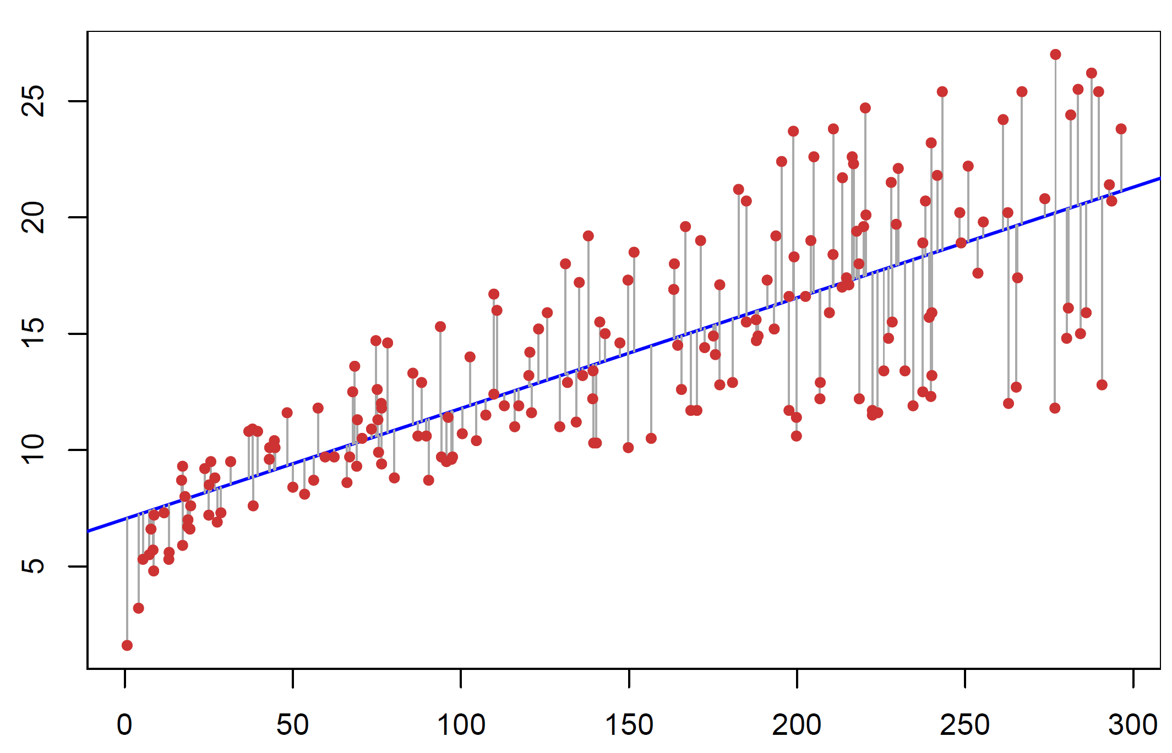
The Big Picture
What is the equation for the “best” line that fits through data comprised of a single input variable for an output/response variable?
Image sources: Simon Sinek How Great Leaders Inspire Action, TED (2009), and ISLP Figure 3.1.

Slide 3
Review and Context
Last week:
We assumed a model
$$Y=f\left(X\right)+ε$$
and thus
$$𝔼\left[Y | X=x\right]=f\left(X\right)+𝔼\left[ε | X\right]$$
$$⇒ 𝔼\left[Y | X=x\right]=f\left(X\right).$$
Since we don’t know the true $f$, we estimate it with $\hat{f}$.
A good estimate $\hat{f}$ of $f$ is one that has low MSE.
$$MSE=Bias^{2}+Var\left(model\right)+Var(ε)$$
Notes:
Think of $X$as the information we can know. Once we condition on $X$, it’s no longer random — it’s fixed.
The only randomness left in $Y$comes from $ε$.
So the conditional expectation $E\left[Y∣X\right]$is just the average value of $Y$over the noise. And because the noise has mean zero, that average is exactly $f\left(X\right)$

Slide 4
Simple Linear Regression
Simple linear regression predicts a quantitative response $Y$ using a single predictor $X$.
We assume the $f$ function is linear:
$$Y=f\left(X\right)+ε=β_{0}+β_{1}X+ε$$
for $ε$ which has $𝔼\left[ε | X=x\right]=0$ for every $x$.
This is a parametric model for $\hat{f}$, using parameters $=β_{0}$ and $β_{1}$.
In the data analysis lingo, we “regress $Y$ onto $X$.”

Slide 5
More Data Analysis Lingo
The observed $Y$ minus predicted $\hat{Y}$ is called a residual.
We denote residuals by $e$. (Some texts denote them by $\hat{ε}$).
For the simple linear model, our observed residuals are
$$e_{i}≔y_{i}−\left({\hat{β}}_{0}+{\hat{β}}_{1}x_{i}\right).$$
The MSE of our estimates ${\hat{β}}_{0},{\hat{β}}_{1}$ can now be written as
$$\frac{1}{n}∑e_{i}^{2}.$$
The Residual Sum of Squares is: $∑e_{i}^{2}.$
Residuals will come up a lot in this course.

Slide 6
Simple linear regression
Challenge:
Identify the coefficients $β_{0}$ and $β_{1}$.
We will denote our estimates of these coefficients ${\hat{β}}_{0}$ and ${\hat{β}}_{1}$.
$$\hat{f}\left(X\right)={\hat{β}}_{0}+{\hat{β}}_{1}X$$
What do each of these coefficients estimate, in a linear sense?

Slide 7
Some Common Assumptions
$$Y=β_{0}+β_{1}X+ε$$
We might make any of the following assumptions, in increasing order of preference.
If $𝔼\left[ε | X=x\right]=0$, then $β_{0}+β_{1}X$ is the conditional mean of $Y|X$, and hence is the best (minimum MSE) predictor for $Y$ given $X$.
If (1) holds, $Var\left[ε | X=x\right]=σ^{2}$ for all $x$, and $ε$ is uncorrelated across observations, we satisfy the assumptions of the Simple Linear Regression Model.
If (1) holds, $ε\sim 𝒩(0,σ^{2})$, and $ε$ is independent across observations, we satisfy the assumptions of the Gaussian Noise Simple Linear Regression Model.
Notes:
Corr = 0 -> independence only if Normal RVs.
Normality gives us exact finite-sample distributions for:
${\hat{β}}_{0},{\hat{β}}_{1}$
t‑statistics
F‑statistics
prediction intervals
Everything becomes exact, not asymptotic.
We can derive exact sampling distributions, use exact t- and F-tests
Construct exact prediction intervals
Use likelihood-based methods

Slide 8
${\hat{β}}_{0}$ and ${\hat{β}}_{1}$
We would like to minimize the MSE $𝔼\left[{\left(Y−\hat{Y}\right)}^{2}\right].$
In practice, however, we have the data $X,$ and cannot compute the expectation $𝔼\left[{\left(Y−\hat{Y}\right)}^{2}\right]$ directly.
Instead, given the observations $\left(x_{1},y_{1}\right),…,(x_{n},y_{n})$ we minimize the empirical mean-squared error:
$$\min_{ }{\frac{1}{n}{\sum_{i=1}^{n}{e_{i}^{2}}}^{ }}=\min_{b_{0},b_{1}}{\frac{1}{n}{\sum_{i=1}^{n}{{\left(y_{i}−\left(b_{0}+b_{1}x_{i}\right)\right)}^{2}}}^{ }.}$$
How do we do this?

Slide 9
Time for some calculus.
Find critical points.
Take partial derivatives wrt $b_{0}$ and $b_{1}$.
Set both equal to $0$. Solve for $b_{0}$ and $b_{1}$.
Use 2nd derivative information to verify that our critical point is minimum.

Slide 10
Calculating ${\hat{β}}_{0}$ and ${\hat{β}}_{1}$
$$\min_{b_{0},b_{1}}{\frac{1}{n}{\sum_{i=1}^{n}{{\left(y_{i}−\left(b_{0}+b_{1}x_{i}\right)\right)}^{2}}}^{ }}$$
First, we take the derivative wrt $b_{0}$.

Slide 11
Calculating ${\hat{β}}_{0}$ and ${\hat{β}}_{1}$
$$\min_{b_{0},b_{1}}{\frac{1}{n}{\sum_{i=1}^{n}{{\left(y_{i}−\left(b_{0}+b_{1}x_{i}\right)\right)}^{2}}}^{ }}$$
First, we take the derivative wrt $b_{0}$.
$$\frac{∂}{∂b_{0}}={−\frac{2}{n}{\sum_{i=1}^{n}{\left(y_{i}−\left(b_{0}+b_{1}x_{i}\right)\right)}}^{ }}$$

Slide 12
Calculating ${\hat{β}}_{0}$ and ${\hat{β}}_{1}$
$$\min_{b_{0},b_{1}}{\frac{1}{n}{\sum_{i=1}^{n}{{\left(y_{i}−\left(b_{0}+b_{1}x_{i}\right)\right)}^{2}}}^{ }}$$
Then, we take the derivative wrt $b_{1}$.
$$\frac{∂}{∂b_{1}}={−\frac{2}{n}{\sum_{i=1}^{n}{x_{i}\left(y_{i}−\left(b_{0}+b_{1}x_{i}\right)\right)}}^{ }}$$

Slide 13
Calculating ${\hat{β}}_{0}$ and ${\hat{β}}_{1}$
Then, we want to solve for ${\hat{β}}_{0}$ and ${\hat{β}}_{1}$ by setting them equal to 0.
Two variables and two unknowns:
$$−\frac{2}{n}{\sum_{i=1}^{n}{\left(y_{i}−\left({\hat{β}}_{0}+{\hat{β}}_{1}x_{i}\right)\right)}=0}^{ }$$
$${−\frac{2}{n}{\sum_{i=1}^{n}{x_{i}\left(y_{i}−\left({\hat{β}}_{0}+{\hat{β}}_{1}x_{i}\right)\right)}}^{ }}=0$$

Slide 14
Calculating ${\hat{β}}_{0}$ and ${\hat{β}}_{1}$
Dividing the $−2$ from each of these equations gives us:
$$\frac{1}{n}{\sum_{i=1}^{n}{\left(y_{i}−\left({\hat{β}}_{0}+{\hat{β}}_{1}x_{i}\right)\right)}=0}^{ }$$
$${\frac{1}{n}{\sum_{i=1}^{n}{x_{i}\left(y_{i}−\left({\hat{β}}_{0}+{\hat{β}}_{1}x_{i}\right)\right)}}^{ }}=0$$
These are called the Normal Equations.
They are important because they determine and give us properties of the $\hat{β}$s.

Slide 15
Calculating ${\hat{β}}_{0}$ and ${\hat{β}}_{1}$
We will denote sample means using the $\overline{bar}$notation. Then
$$\frac{1}{n}{\sum_{i=1}^{n}{\left(y_{i}−\left({\hat{β}}_{0}+{\hat{β}}_{1}x_{i}\right)\right)}=0}^{ }$$
$${\frac{1}{n}{\sum_{i=1}^{n}{x_{i}\left(y_{i}−\left({\hat{β}}_{0}+{\hat{β}}_{1}x_{i}\right)\right)}}^{ }}=0$$
Becomes
$$\overline{y}−\left({\hat{β}}_{0}+{\hat{β}}_{1}\overline{x}\right)=0$$
$$\overline{xy}−\left({\hat{β}}_{0}\overline{x}+{\hat{β}}_{1}\overline{x^{2}}\right)=0$$
After distributing the sums across each term.
$\overline{Bar}$ notation- Recall:
$$\overline{x}=\frac{1}{n}\sum_{i=1}^{n}{x_{i}}$$

Slide 16
Calculating ${\hat{β}}_{0}$ and ${\hat{β}}_{1}$
To solve for ${\hat{β}}_{1}$, we multiply the top equation by $−\overline{x}$ and add it to the bottom equation:
$$\overline{xy}−\overline{x}\overline{y}−{\hat{β}}_{0}\overline{x}+{\hat{β}}_{0}\overline{x}−{\hat{β}}_{1}\overline{x^{2}}+{\hat{β}}_{1}{\overline{x}}^{2}=0$$
(Note that $\overline{xy}$ and $\overline{x}\overline{y}$ are not the same thing!) We then have
$$\overline{xy}−\overline{x}\overline{y}−{\hat{β}}_{1}\overline{x^{2}}+{\hat{β}}_{1}{\overline{x}}^{2}=0$$
Solving for ${\hat{β}}_{1}$ we get
$${\hat{β}}_{1}=\frac{\overline{xy}−\overline{x}\overline{y}}{\overline{x^{2}}−{\overline{x}}^{2}}.$$

Slide 17
Calculating ${\hat{β}}_{0}$ and ${\hat{β}}_{1}$
Similarly, from the original equation
$$\overline{y}−\left({\hat{β}}_{0}+β_{1}\overline{x}\right)=0$$
we solve for ${\hat{β}}_{0}$:
$${\hat{β}}_{0}=\overline{y}−β_{1}\overline{x.}$$

Slide 18
et Voilà.
$${\hat{β}}_{0}=\overline{y}−β_{1}\overline{x}$$
$${\hat{β}}_{1}=\frac{\overline{xy}−\overline{x}\overline{y}}{\overline{x^{2}}−{\overline{x}}^{2}}$$
A little mathing shows that ${\hat{β}}_{0}$ (which is what again?) is the relationship between the means of observed $y$ and $x$values.
But how do we interpret ${\hat{β}}_{1}?$

Slide 19
Some More Algebra
We can use the fact that
$$\frac{1}{n}\sum_{i=1}^{n}{(x_{i}−\overline{x})(y_{i}−\overline{y})}=\frac{1}{n}\sum_{i=1}^{n}{x_{i}y_{i}−y_{i}\overline{x}−x_{i}\overline{y}+\overline{x}\overline{y}}$$
$$=\overline{xy}−\overline{x}\overline{y}−\overline{x}\overline{y}+\overline{x}\overline{y}$$
$$=\overline{xy}−\overline{x}\overline{y}.$$

Slide 20
Some More Algebra
Similarly
$$\frac{1}{n}\sum_{i=1}^{n}{{\left(x_{i}−\overline{x}\right)}^{2}}=\frac{1}{n}\sum_{i=1}^{n}{(x_{i}−\overline{x})(x_{i}−\overline{x})}$$
$$=\overline{x^{2}}−{\overline{x}}^{2}.$$

Slide 21
Equivalences
These are all equivalent:
$${\hat{β}}_{1}=\frac{\frac{1}{n}\sum_{i=1}^{n}{(x_{i}−\overline{x})(y_{i}−\overline{y})}}{\frac{1}{n}\sum_{i=1}^{n}{{\left(x_{i}−\overline{x}\right)}^{2}}}$$
$${\hat{β}}_{1}=\frac{\sum_{i=1}^{n}{(x_{i}−\overline{x})(y_{i}−\overline{y})}}{\sum_{i=1}^{n}{{\left(x_{i}−\overline{x}\right)}^{2}}}$$
$${\hat{β}}_{1}=\frac{\frac{1}{n−1}\sum_{i=1}^{n}{(x_{i}−\overline{x})(y_{i}−\overline{y})}}{\frac{1}{n−1}\sum_{i=1}^{n}{{\left(x_{i}−\overline{x}\right)}^{2}}}$$
(Using one of the “you can’t stop me” rules.)

Slide 22
Recall from OA3102
The unbiased sample covariance and variance are:
$$s_{xy}≔\frac{1}{n−1}\sum_{i=1}^{n}{(x_{i}−\overline{x})(y_{i}−\overline{y})}$$
and
$$s_{x}^{2}≔\frac{1}{n−1}\sum_{i=1}^{n}{{\left(x_{i}−\overline{x}\right)}^{2}.}$$

Slide 23
Recall from OA3102
The biased sample covariance and variance are:
$${\hat{σ}}_{xy}≔\frac{1}{n}\sum_{i=1}^{n}{(x_{i}−\overline{x})(y_{i}−\overline{y})}$$
and
$${\hat{σ}}_{x}^{2}≔\frac{1}{n−1}\sum_{i=1}^{n}{{\left(x_{i}−\overline{x}\right)}^{2}.}$$

Slide 24
The Least Squares Estimators
Our derivation for ${\hat{β}}_{0}$ and ${\hat{β}}_{1}$ are called the Least Squares Estimators because they minimize the empirical mean squared error.
Note: We showed that ${\hat{β}}_{0}$ and ${\hat{β}}_{1}$ are critical points. We can further take the second derivatives to show they are indeed minimizers. For sanity and time we won’t do that here.

Slide 25
The Takeaways
We have shown that
$${\hat{β}}_{0}=\overline{y}−{\hat{β}}_{1}\overline{x}$$
which we can interpret as “The $y$-intercept is a linear relationship between the sample means of the observations of $x$ and $y.$”
Also:
$${\hat{β}}_{1}=\frac{{\hat{σ}}_{xy}}{{\hat{σ}}_{x}^{2}}=\frac{s_{xy}}{s_{x}^{2}}$$
which we can interpret as “The slope is a proportion of the sample covariance of $x$ and $y$ and sample variance of $x$.”
Notes:
The slope is:
How much $y$changes, on average, for a one‑unit change in $x$.
And the formula
${\hat{β}}_{1}=\frac{s_{xy}}{s_{x}^{2}}$
tells us why:
The numerator $s_{xy}$measures how $x$and $y$move together.
The denominator $s_{x}^{2}$measures how much $x$varies on its own.
So the slope is:
The amount of co‑movement between $x$and $y$, scaled by how much $x$varies.
Also, the sign is dependent on the covariance.

Slide 26
Interpretation
$$𝔼\left[Y | X\right]=β_{0}+β_{1}X≈{\hat{β}}_{0}+{\hat{β}}_{1}X$$
The intercept ${\hat{β}}_{0}$: An estimate of $𝔼[Y]$ when $X=0$.
The slope ${\hat{β}}_{1}:$ An estimate of the increase in $𝔼[Y]$ when $X$ increases $1$unit.

Slide 27
An Application
The slope ${\hat{β}}_{1}:$ An estimate of the increase in $𝔼[Y]$ when $X$ increases $1$unit.
Suppose we have a regression problem where $X$ is the height of mercury in a thermometer and $Y$ is the ambient temperature. We have clean data and performed EDA, and now use SLR to estimate ${\hat{β}}_{1}$.
Question: How much do we expect the temperature to rise if we artificially increase the height of the mercury by $1$unit?
Answer: ZERO! Remember our EDA and understanding of what the data tells us in the first place. We cannot let correlation imply causation here!

Slide 28
Follow-up From Yesterday #1
On Variance and Covariance notation:
We denote the unbiased sample variance for as $s_{x}^{2}$.
We denote the unbiased sample covariance as $s_{xy}$.
Where did the square go?
The statistical derivation reason:
Variance is the second-centralized moment: $𝔼\left[{\left(X−μ\right)}^{2}\right]$
It reports spread of a single distribution.
Ex: Skewness is the third-standardized moment: $\frac{𝔼\left[{\left(X−μ\right)}^{3}\right]}{σ^{3}}$
Second moment $→$square superscript
Covariance, on the other hand, is a cross-moment that measures co-movement between variables.
Not a second moment $→$ no square

Slide 29
Etymology of notation
On Variance and Covariance notation:
We denote the unbiased sample variance for as $s_{x}^{2}$.
We denote the unbiased sample covariance as $s_{xy}$.
Where did the square go?
The units reason:
$Var\left[X\right]$takes the units-squared of our random variable:
If $X$ is in meters, $Var[X]$ is in $m^{2}$.
If $X$ is in dollars, $Var\left[X\right]$ is evil.
Covariance, on the other hand, has units of:
meters $×$ seconds
dollars $×$ years
inches $×$lbs.

Slide 30
Follow-up From Yesterday #2
Do we ever select the biased estimators ${\hat{σ}}_{x}^{2}$ and $σ_{xy}$ instead of the unbiased estimators $s_{x}^{2}$and $s_{xy}$ on purpose?
Answer: Yes.
Remember the bias-variance tradeoff?
In OA3102 you showed
$$𝔼\left[{\hat{σ}}^{2}\right]=\frac{n−1}{n}σ^{2},$$
which is biased. That’s why $s^{2}=\frac{n}{n−1}{\hat{σ}}^{2}.$ Thus
$$𝔼\left[s^{2}\right]=σ^{2}$$
which is unbiased.
But
$$Var\left[s^{2}\right]={\left(\frac{n}{n−1}\right)}^{2}Var\left[{\hat{σ}}^{2}\right]$$
which means
$$Var\left[s^{2}\right]>Var\left[{\hat{σ}}^{2}\right],$$
so the unbiased estimator has higher variance.

Slide 31
Biased vs Unbiased Estimators
Do we ever select the biased estimators ${\hat{σ}}_{x}^{2}$ and $σ_{xy}$ instead of the unbiased estimators $s_{x}^{2}$and $s_{xy}$ on purpose?
When we might select the biased estimators:
Strictly going for minimum MSE
Doing maximum likelihood estimation (MLE)
We care about prediction, but not inference
Examples: ML, signal processing, econometrics
When we might select the unbiased estimators:
Performing classical inference
Constructing confidence intervals (CIs)
Hypothesis testing
Later, we will work with Ridge and Lasso regression, which are intentionally biased to reduce MSE!
Notes:
Bottom line: “bias” shouldn’t have a stigma attached to it. The unbiased estimator is indeed unbiased by its mathematical definition… but it is not always best.

Slide 32
Biased vs Unbiased Estimators
Variance and Covariance Defaults in R and Python- It turns out different packages use different calculations for $Var$ and $Cov$:
Ecosystem / Package | Variance Code / Default Setting | Covariance Code/ Default Setting | Reasoning
R (base) | var | cov | Classical statistics; inference-oriented
 | Unbiased (n-1) | Unbiased (n-1)
Python/Pandas | Series.var | DataFrame.cov | Classical statistics defaults
 | Unbiased (n-1) | Unbiased (n-1)
Python/NumPy | np.var | np.cov | Numerical linear algebra roots; MLE for
 | Biased (n) | Unbiased (n-1) | variance, known historical inconsistency
Python/sklearn | Biased (n)* | Biased (n)* | ML-oriented; optimization over inference, MLE
Python/statsmodels | Unbiased (n-1)* | Unbiased (n-1)* | Designed to mirror R; inference oriented.
*internally: no specific code to calculate variance/covariance

Slide 33
Do we need to mindfully select the correct package in R and/or Python?
Fortunately, no.
The functions we use (ex: lm() in R) automatically select the correct interpretation.
We will (hopefully) rarely directly calculate $Var$ or $Cov$ for our analyses.

Slide 34
Follow-up From Yesterday #3
How does covariance between observed $x_{i}$ and $y_{i}$ affect the slope parameter $β_{1}$?
Explore the Slope vs Cov and Var.ipynb file in Sakai.

Slide 35
The Least Squares Estimators for a Single Input Variable $X$
Our derivations for ${\hat{β}}_{0}$ and ${\hat{β}}_{1}$ called the Least Squares Estimators because they minimize the empirical mean squared error.
We literally built these parameters by deliberately minimizing the mean squared error via calculus.

Slide 36
Interpretation of ${\hat{β}}_{0}$ and ${\hat{β}}_{1}$ for SLR
We showed the y-intercept parameter is:
$${\hat{β}}_{0}=\overline{y}−{\hat{β}}_{1}\overline{x}$$
which we can interpret as “The $y$-intercept is a linear relationship between the sample means of the observations of $x$ and $y.$”
Also the slope parameter is:
$${\hat{β}}_{1}=\frac{{\hat{σ}}_{xy}}{{\hat{σ}}_{x}^{2}}=\frac{s_{xy}}{s_{x}^{2}}$$
which we can interpret as “The slope is a proportion of the sample covariance of $x$ and $y$ and sample variance of $x$.”
Notes:
The slope is:
How much $y$changes, on average, for a one‑unit change in $x$.
And the formula
${\hat{β}}_{1}=\frac{s_{xy}}{s_{x}^{2}}$
tells us why:
The numerator $s_{xy}$measures how $x$and $y$move together.
The denominator $s_{x}^{2}$measures how much $x$varies on its own.
So the slope is:
The amount of co‑movement between $x$and $y$, scaled by how much $x$varies.
Also, the sign is dependent on the covariance.

Slide 37
Interpretation of ${\hat{β}}_{0}$ and ${\hat{β}}_{1}$ for SLR
$$𝔼\left[Y | X\right]=β_{0}+β_{1}X≈{\hat{β}}_{0}+{\hat{β}}_{1}X$$
The intercept ${\hat{β}}_{0}$: An estimate of $𝔼[Y]$ when $X=0$.
The slope ${\hat{β}}_{1}:$ An estimate of the increase in $𝔼[Y]$ when $X$ increases $1$unit.

Slide 38
Some Common Assumptions
$$Y=β_{0}+β_{1}X+ε$$
We might make any of the following assumptions, in increasing order of preference.
If $𝔼\left[ε | X=x\right]=0$, then $β_{0}+β_{1}X$ is the conditional mean of $Y|X$, and hence is the best (minimum MSE) predictor for $Y$ given $X$.
If (1) holds, $Var\left[ε | X=x\right]=σ^{2}$ for all $x$, and $ε$ is uncorrelated across observations, we satisfy the assumptions of the Simple Linear Regression Model.
If (1) holds, $ε\sim 𝒩(0,σ^{2})$, and $ε$ is independent across observations, we satisfy the assumptions of the Gaussian Noise Simple Linear Regression Model.

Slide 39
Back to R and Python
I will introduce the basic commands for doing an SLR fit in R, followed by Python.
Jupyter Notebook - Simulation to explore effects of $Var(x)$ and $Cov(x,y)$ on slope.
Examine datasets of your choice in R and Python.
You should now have all the tools you need to complete HW1.

Slide 40
Goals for Today
Further our understanding of evaluating linear models by leveraging intuition from OA3102.
$R^{2}≔$ how much of the variation in $Y$ is explained by $X$
F-statistic$≔$ the statistical significance of our linear model

Slide 41
Concept Review: Estimating One-Dimensional Data
We evaluate how good our estimate is by the Mean Square Error (MSE)
The MSE of one-dimensional data is Variance.
Weight

Slide 42
When we have an additional variable…
We want to evaluate if knowing something else about the data points (some set of $x_{i}$ for each $y_{i}$) tells us more than just the $y_{i}$ data by itself.

Slide 43
When we have an additional variable
If we have two data points, we can fit a line perfectly between them.

Slide 44
When we have an additional variable
But what if we have more?
In linear algebra, this meant we were overdetermined.

Slide 45
When we have an additional variable
So last week, we fit the line using the least squares estimator.
But how good is this fit?

Slide 46
An Intuitive Look
Pediatric Patients: Estimating Weight
Which of these two is a more effective predictor of weight?
Weight
Weight
Height
Favorite Color

Slide 47
Again: MSE
We look at the vertical distances of the data points to our prediction.
What are these called again?
In this case, we square each of these distances, and take their mean. (MSE)

Slide 48
Simple Linear Regression
Last week we used calculus to find the slope and the y-intercept of the Least Squares Estimator (LSE) line.
We proved that the LSE is the solution that minimizes MSE.

Slide 49
Simple Linear Regression
Think of choosing the slope and y-intercept as rotating the best fit line, and calculating the resulting MSE.

Slide 50
Simple Linear Regression
If we plot that rotation vs MSE, then what we did was select the rotation at the bottom of the curve.
Calculated MSE
$\hat{y}={\hat{β}}_{1}x+{\hat{β}}_{0}$

Slide 51
Simple Linear Regression
With univariate data (just $y_{i}$) we said the best estimate was the mean.
Weight

Slide 52
Simple Linear Regression
With two-dimensional data, notice the $y_{i}$ values are the same. They are just ordered differently WRT the predictors $x_{i}$.
Weight
Weight
Weight
Height
Favorite Color

Slide 53
Simple Linear Regression
If the estimator is essentially meaningless, then the slope ${\hat{β}}_{1}=0$ and the y-intercept ${\hat{β}}_{0}=𝔼[Y]$.
Weight
Weight
Favorite Color

Slide 54
Simple Linear Regression
In other words, when the predictor variable is not useful at all, the sums of the squared errors (residuals) is the same as the sum of the squared errors of $\left\{y_{i}\right\}$ by itself, $Var[Y]$.
Weight
Weight
Favorite Color

Slide 55
Takeaway
We can say that predicting $Y$ using just the observed $y_{i}$ itself is the same as predicting $Y$ using $(x_{i},y_{i})$ when the least squares estimator line has zero slope.

Slide 56
Meaningful Predictor
When we do see a predictor variable that appears to have meaning, then we would fit a line with a non-zero slope.
Weight
Height

Slide 57
Simple Linear Regression
In this case, we expect the sum of the squared errors to be less than if we had predicted $Y$ as $𝔼[Y]$.
Weight
Weight
Height

Slide 58
$R^{2}$: Measure of how much a predictor variable tells us
How much of the variation in $Y$ does the model explain with $X$?
$$R^{2}=\frac{TSS−RSS}{TSS}$$
$TSS$: Total Sum of Squares
$RSS$: Residual Sum of Squares

Slide 59
$R^{2}$: Measure of how much a predictor variable tells us
How much of the variation in $Y$ does the model explain with $X$?
$$R^{2}=\frac{SS_{mean only }−SS_{fit}}{SS_{mean only}}$$

Slide 60
Let’s unpack this some more
What is the worst we can ever do?
If our predictor is the same as taking the mean of $Y$ without considering the predictor, $R^{2}=0$.
$R^{2}=\frac{SS_{mean only }−SS_{fit}}{SS_{mean only}}$
Weight
Weight
Favorite Color

Slide 61
Let’s unpack this some more
What is the best we can ever do?
If our predictor and response variables form a straight line, the residuals are all zero.
$R^{2}=1$
$R^{2}=\frac{SS_{mean only }−SS_{fit}}{SS_{mean only}}$
Weight
Weight
61
Amazing Predictor

Slide 62
Why this works
Recall the first of our “big three” assumptions:
Weight
Weight
Weight
Height
Favorite Color

Slide 63
Takeaways
$R^{2}∈[0,1]$.
If we have a predictor with an $R^{2}$ value of $0.25$ (ex: wrist circumference) and another predictor with $R^{2}=0.50$ (ex: height), we can say that
“Height explains twice as much variance as wrist circumference when estimating weights of pediatric patients aged 12.”
Good to know, but not as useful for MLR:
Recall correlation: $r=Cor\left(X,Y\right)=\frac{Cov\left(X,Y\right)}{\sqrt{Var\left[X\right]Var\left[Y\right]}}$
It turns out that $R^{2}=r^{2}$

Slide 64
Limitations
$R^{2}$ doesn’t tell us everything.
Example: What if we had only two data points?

Slide 65
Limitations
Example: What if we had only two data points?
$SSE=0 ⇒R^{2}=1$. A perfect fit!

Slide 66
Limitations
$SSE=0 ⇒R^{2}=1$. A perfect fit!
But what if we start applying it to test data?

Slide 67
Limitations
Therefore, $R^{2}$ alone does not tell us whether the model is statistically meaningful.
$R^{2}$ doesn’t tell us whether the slope is distinguishable from zero.
It measures fit, not statistical evidence.
Does not account for sampling variability, noise level, or uncertainty of the estimated slope.

Slide 68
Enter: The F-test
We want to get a statistical significance of our fit.

Slide 69
Decomposition and Comparison to $R^{2}$
$R^{2}$ can be rewritten as
$$R^{2}=\frac{\frac{1}{n−1}}{\frac{1}{n−1}}×\frac{SS_{mean only }−SS_{fit}}{SS_{mean only}}$$
(using a “can’t stop me” rule).
This means, in variance terms:
$$R^{2}=\frac{Var\left[mean only\right]−Var\left[fit residuals\right]}{Var\left[mean only\right]}$$

Slide 70
Decomposition and Comparison to $R^{2}$
In variance terms:
$R^{2}=\frac{Var\left[mean only\right]−Var\left[fit residuals\right]}{Var\left[mean only\right]}$
$=\frac{Reduction in Variation when considering height}{Variation in weight without considering height}$
Weight
Weight
Height

Slide 71
F-statistic
In variance terms:
$f_{observed}=\frac{Var\left[mean only\right]−Var\left[fit residuals\right]}{Var\left[fit residuals\right]}$
$=\frac{Reduction in Variation when considering height}{Variation in weight not explained by height}$
The numerator is the same as $R^{2}.$
The denominator is slightly different.
Weight
Weight
Height

Slide 72
F-statistic
Mathematically, given $p$ parameters and $n$observations:
$$f_{observed}=\frac{\frac{SS_{mean only}−SS_{fit}}{p_{fit}−p_{mean only}}}{\frac{SS_{fit}}{n−p_{fit}}}$$

Slide 73
F-statistic
Mathematically, given $p$ parameters and $n$observations:
$$f_{observed}=\frac{\frac{SS_{mean only}−SS_{fit}}{p_{fit}−p_{mean only}}}{\frac{SS_{fit}}{n−p_{fit}}}$$
In SLR, ${ p}_{fit}=2 ({\hat{β}}_{0}$ and ${\hat{β}}_{1}$), while ${ p}_{mean only}=1$ ($\overline{y}).$

Slide 74
F-statistic
Mathematically, given $p$ parameters and $n$observations:
$$F=\frac{SS_{mean only}−SS_{fit}}{\frac{SS_{fit}}{n−p_{fit}}}$$
What happens to the F-statistic as the number of observations $n$ gets larger?

Slide 75
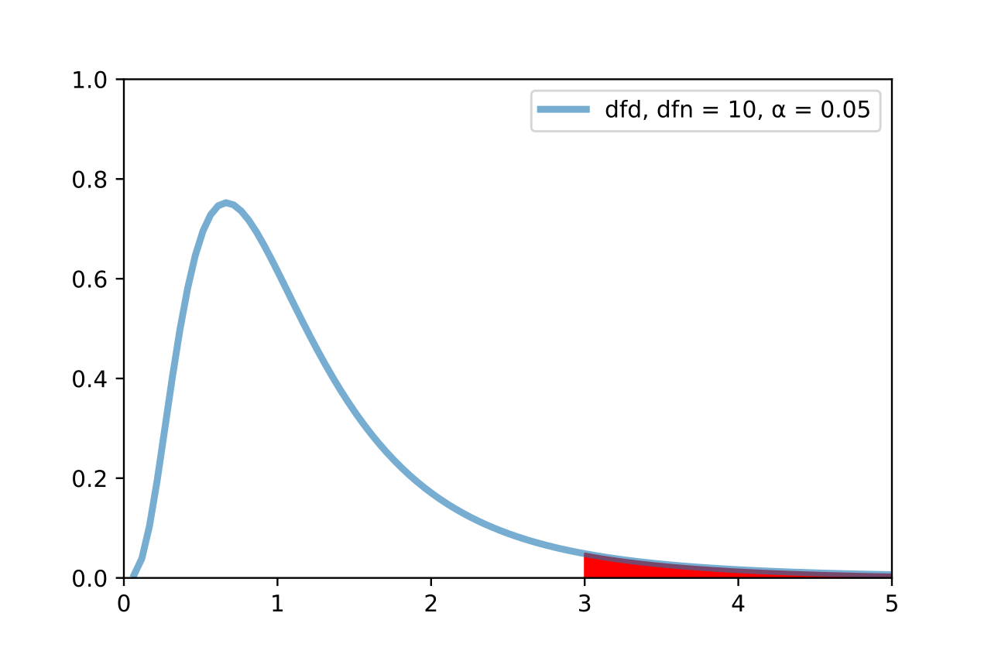
The F-Distribution
We then use the F-Distribution to calculate a p-value.
$$p=𝒫(F_{df\left(numerator\right),df\left(denominator\right)}≥f_{observed})$$
Image adapted from F-test plot.svg, Gase456, CC by 4.0. Retrieved from https://en.wikipedia.org/wiki/F-test.

Slide 76
Mathematical Interpretation
The F-test answers:
Does this model beat the null (random) model? (Think: favorite color vs weight of our pediatric patients)
Is there evidence that the slope is not zero?
Hypothesis test:
$$H_{0}:β_{1}=0 vs H_{A}:β_{1}≠0$$

Slide 77
Why this works
Recall the second “big three” assumption:
And the third “big three” assumption:
And the uncorrelated assumption from #2 automatically gives us independence with the Normal/Gaussian assumption.

Slide 78
What about the t-tests?
In R and Python/statsmodels, we see linear model summary output with t-test p-values as well.
For SLR, the t-test for ${\hat{β}}_{1}$ is mathematically equivalent to the F-test.
In MLR, they diverge. We will get into that later this week.

Slide 79
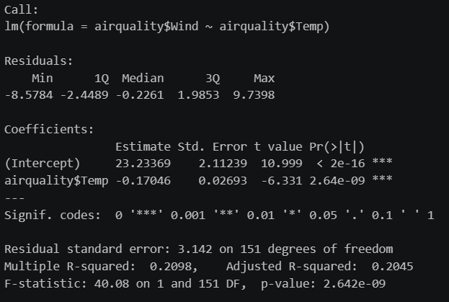
R Output
Recall that in R we use the fit <- lm()command. The summary of that fit looks like this:
The Y (response) regressed onto X (predictor).
The distribution of the residuals.
The fitted ${\hat{β}}_{0}$ y-intercept value.
The fitted ${\hat{β}}_{1}$ slope value. Note that its t-statistic has the same p-val as the F-statistic.
The $R^{2}$value. More on adjusted $R^{2}$ in MLR.
F-statistic and its p-value.

Slide 80
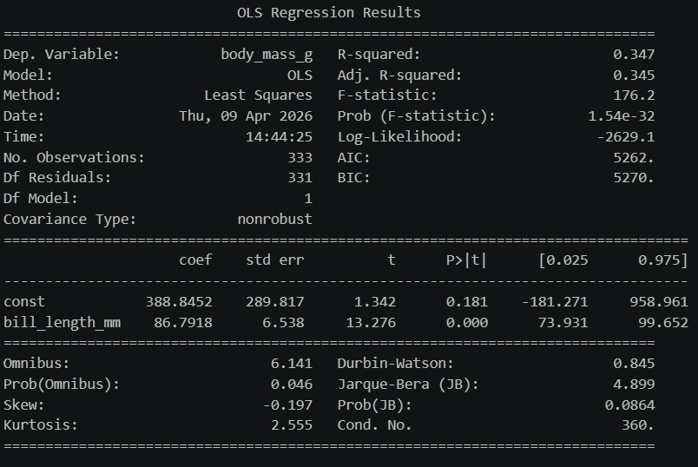
Python Output
In Python, with statsmodels imported as sm, we build a design matrix (more on that tomorrow) and the output looks like:
The Y (response) is the dependent variable.
The X (predictor) variable.
The $R^{2}$value.
F-statistic and its p-value.
The fitted ${\hat{β}}_{0}$ y-intercept value.
The fitted ${\hat{β}}_{1}$ slope value.

Slide 81
Back to R and Python
Open up your notebooks and datasets from Thursday.
Using visual EDA (scatterplot matrices and/or correlation heatmaps), compare $R^{2}$ values and F-test p-values between different variables.

Slide 82
Later …
The datasets we have been looking at have multiple input/predictor variables.
What is the effect of regressing $Y$ onto more than one variable?
How much better does our predictive power get if we add more parameters?
Is there a point of diminishing returns, and how do we know?
Which variables should we use? Which variables shouldn’t we use?

